Slide 1
Theory of Computation Unit # 7 Turing Machine
Prof. Ritesh Upadhyay
Assistant Professor, Dept. of Computer Engg.
UVPCE, Ganpat University, Mehsana

Slide 2
Chapter # 7 - Turing Machine
Introduction: Turing Machine was invented by Alan Turing in 1936 and it is used to accept Recursive Enumerable Languages (generated by Type-0 Grammar)
A Turing machine consists of a tape of infinite length on which read and writes operation can be performed. The tape consists of infinite cells on which each cell either contains input symbol or a special symbol called blank. It also consists of a head pointer which points to cell currently being read and it can move in both directions.

Slide 3
A TM is expressed as a 7-tuple (Q, T, B, ∑, δ, q0, F) where:
Q is a finite set of states
T is the tape alphabet (symbols which can be written on Tape)
B is blank symbol (every cell is filled with B except input alphabet initially)
∑ is the input alphabet (symbols which are part of input alphabet)
δ is a transition function which maps Q × T → Q × T × {L,R}. Depending on its present state and present tape alphabet (pointed by head pointer), it will move to new state, change the tape symbol (may or may not) and move head pointer to either left or right.
q0 is the initial state
F is the set of final states. If any state of F is reached, input string is accepted.

Slide 4
Comparison with the previous automaton :
The following table shows a comparison of how a Turing machine differs from Finite Automaton and Pushdown Automaton.
Automata | Stack Data Structure | Deterministic/Non Deterministic
Finite Automata | N.A. | Deterministic
Push Down Automata | Last in first out(LIFO) | Non-Deterministic
Turing Machine | Infinite Tape | Deterministic

Slide 5
Time and Space Complexity of a Turing Machine
For a Turing machine, the Time complexity refers to the measure of the number of times the tape moves when the machine is initialized for some input symbols Time complexity all reasonable functions −
T(n) = O(n log n)
Space complexity is the number of cells of the tape written.
TM's space complexity −
S(n) = O(n)

Slide 6
Types of Turing Machine : Turing Machine is generally classified into three types
Turing machine as Language Recognizer
Turing machine as Language Generator(Enumerator )
Turing machine as Output Generator (Transducers )
1.Turing machine as Language Recognizer : Turing which Accept or reject the formal language, such kind of Turing machine is known Turing machine as Language recognizer
String Y
N
Turing machine

Slide 7
2.Turing Machine as Language Generator :
The Another type of Turing Machine is language generator, it is also know as language “Enumerator” because in this, Turing machine take a String as a input and generator another string as a output.
String String
Turing Machine as language Generator

Slide 8
3.Turing Machine as Output Generator :
Turing machine as output generator is a Turing machine, in which it take string as input and produce the another string as a output.
This Turing machine is also known as a
“ Transducers”

Slide 9
Variation of Turing Machine
1. Multiple track Turing Machine:
A k-tack Turing machine(for some k>0) has k-tracks and one R/W head that reads and writes all of them one by one.
A k-track Turing Machine can be simulated by a single track Turing machine
2. Two-way infinite Tape Turing Machine:
Infinite tape of two-way infinite tape Turing machine is unbounded in both directions left and right.
Two-way infinite tape Turing machine can be simulated by one-way infinite Turing machine(standard Turing machine).

Slide 10
3. Multi-tape Turing Machine:
It has multiple tapes and controlled by a single head.
The Multi-tape Turing machine is different from k-track Turing machine but expressive power is same.
Multi-tape Turing machine can be simulated by single-tape Turing machine.
4. Multi-tape Multi-head Turing Machine:
The multi-tape Turing machine has multiple tapes and multiple heads
Each tape controlled by separate head
Multi-Tape Multi-head Turing machine can be simulated by standard Turing machine.

Slide 11
5. Multi-dimensional Tape Turing Machine:
It has multi-dimensional tape where head can move any direction that is left, right, up or down.
Multi dimensional tape Turing machine can be simulated by one-dimensional Turing machine
6. Multi-head Turing Machine:
A multi-head Turing machine contain two or more heads to read the symbols on the same tape.
In one step all the heads sense the scanned symbols and move or write independently.
Multi-head Turing machine can be simulated by single head Turing machine.
7. Non-deterministic Turing Machine:
A non-deterministic Turing machine has a single, one way infinite tape.
For a given state and input symbol has atleast one choice to move (finite number of choices for the next move), each choice several choices of path that it might follow for a given input string.
A non-deterministic Turing machine is equivalent to deterministic Turing machine.

Slide 12
Acceptance Mechanism of Turing Machine as Language Recognizer :
By Reading the string ,Turing Machine halts into final state then string is said to be Accepted and
If Turing Machine halts in Non final state then string is said to be Rejected.

Slide 13
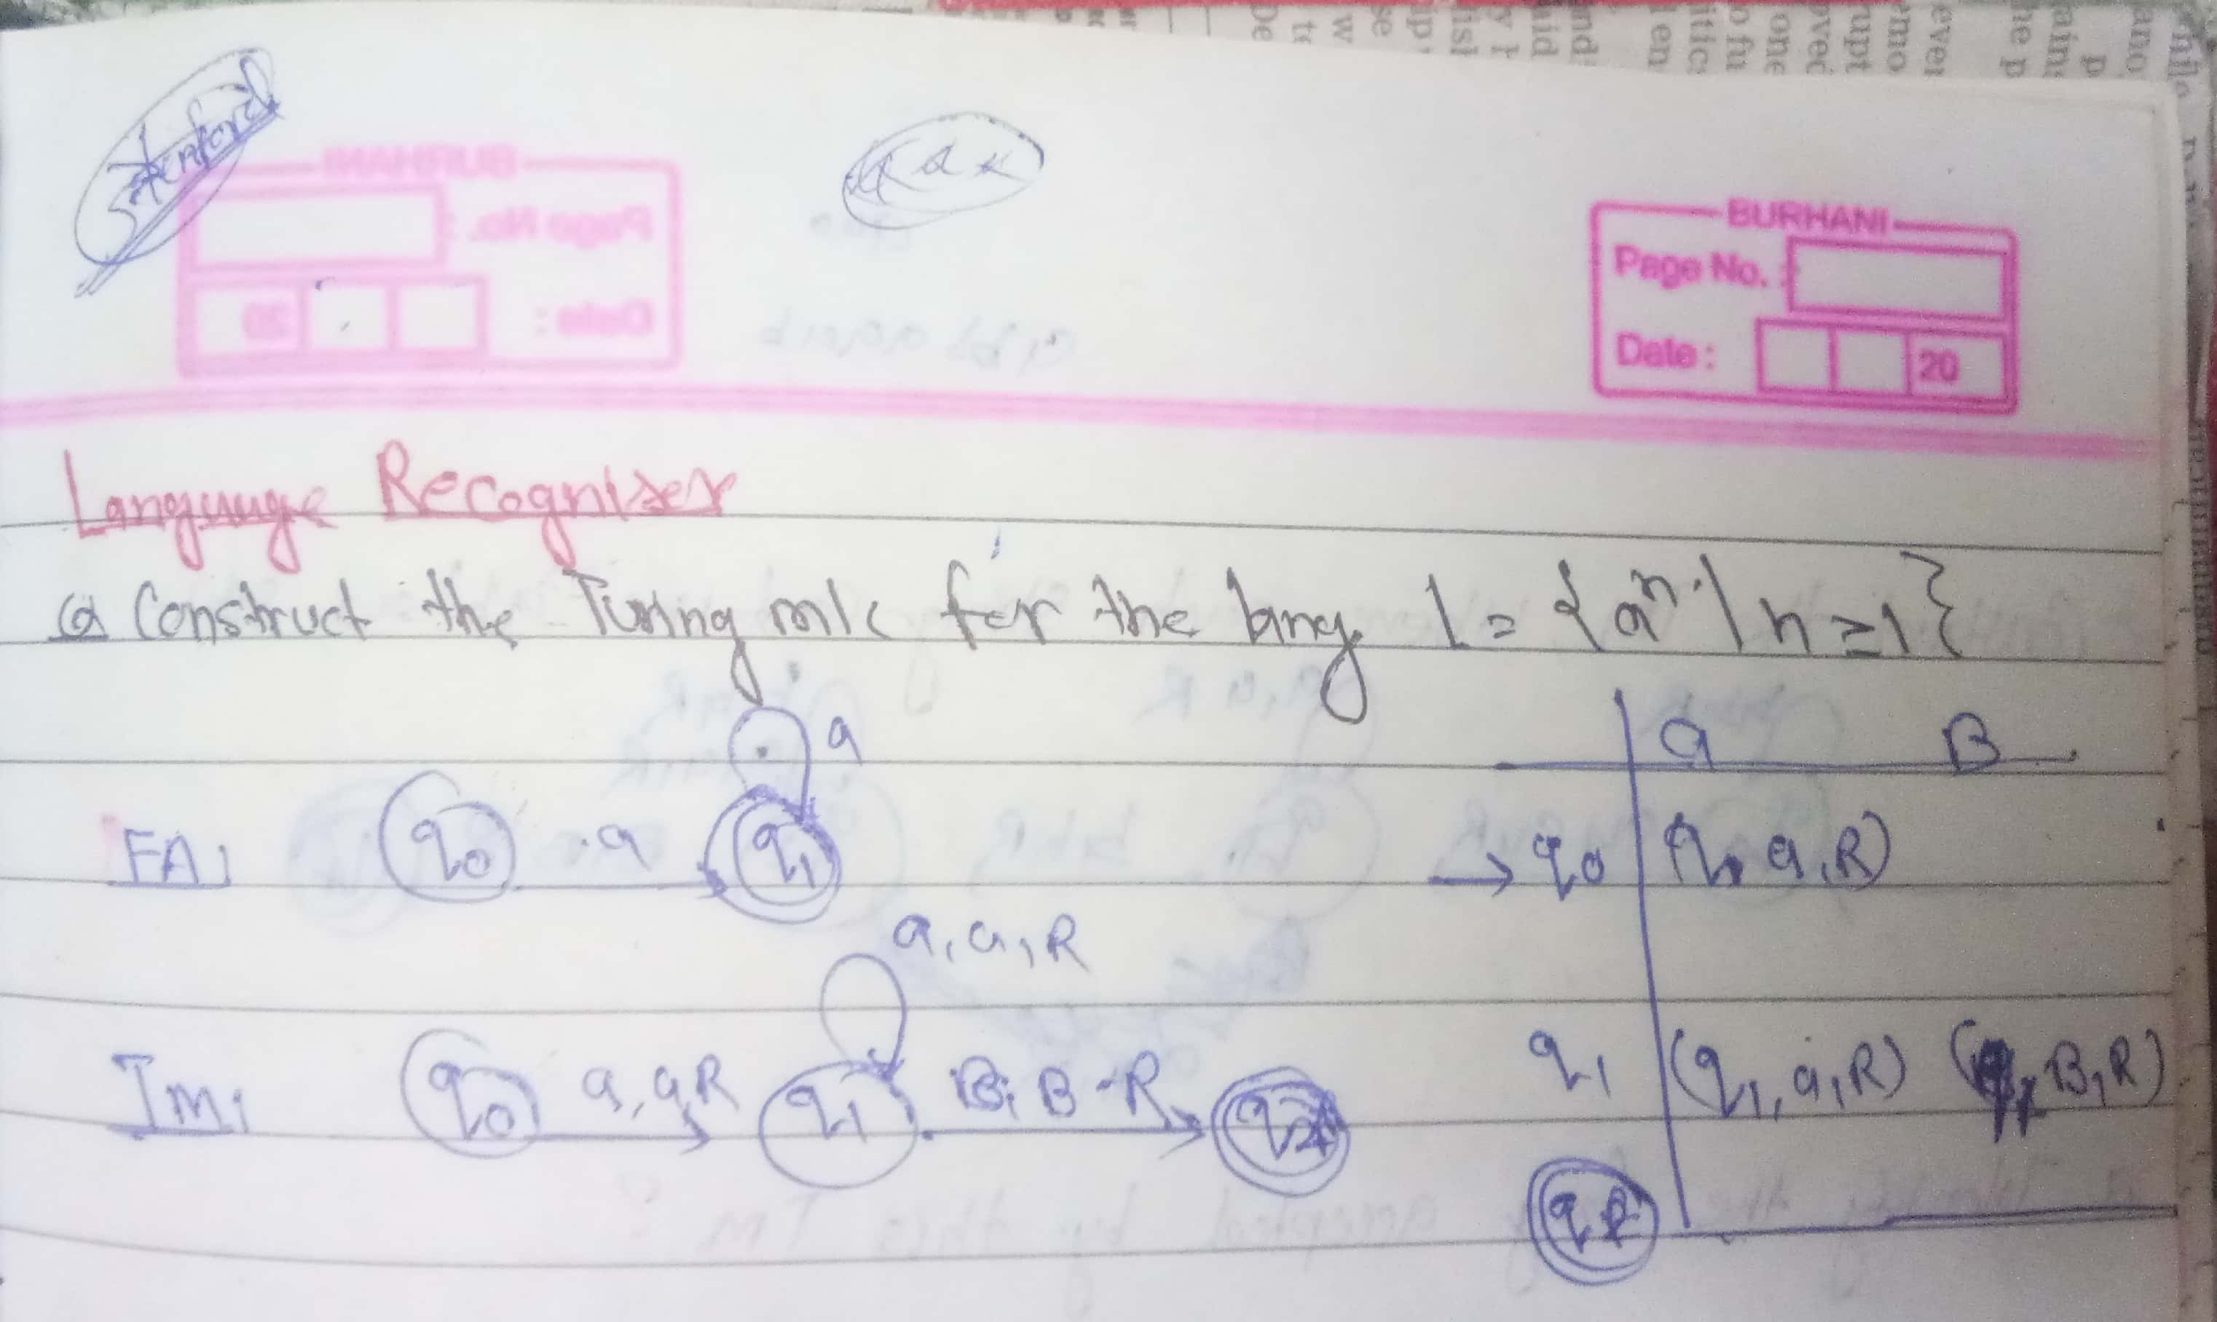
Problems on Language Recognizer
Problem -1

Slide 14
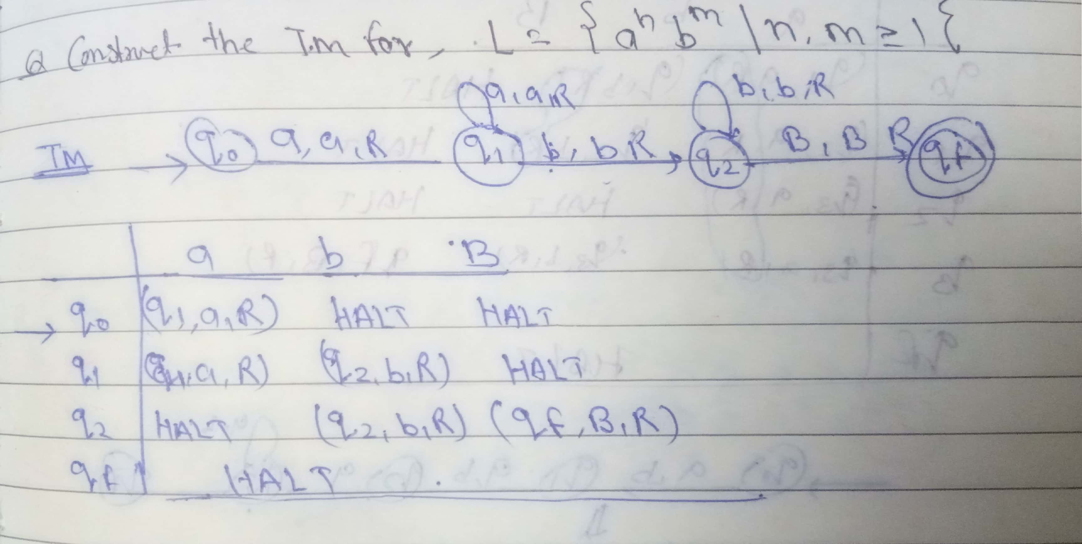
Problem-2

Slide 15
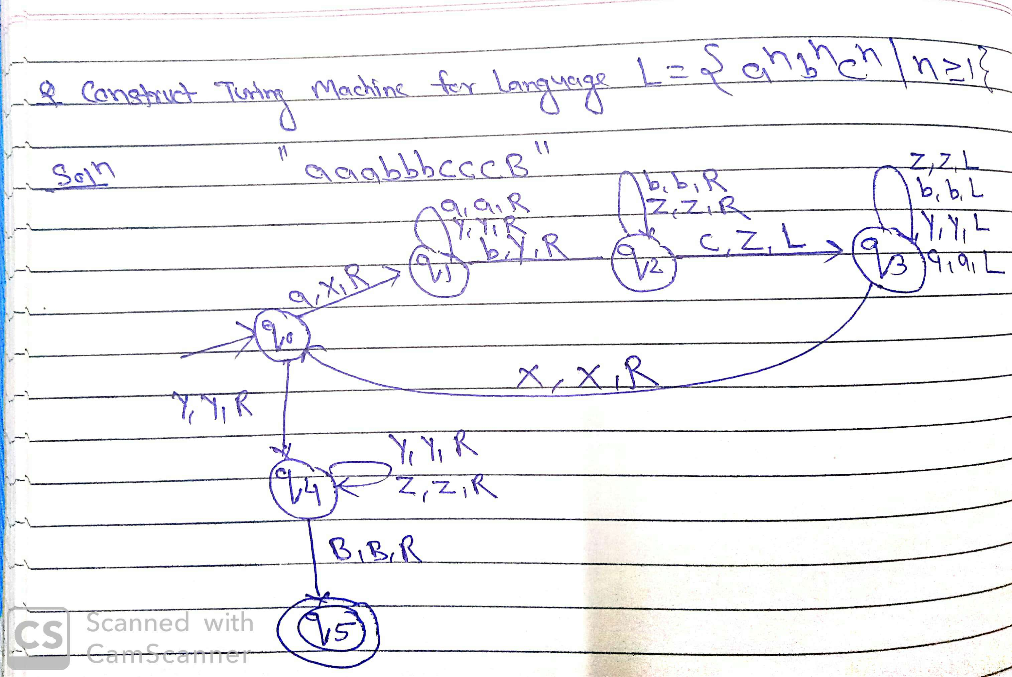
Problem-3

Slide 16
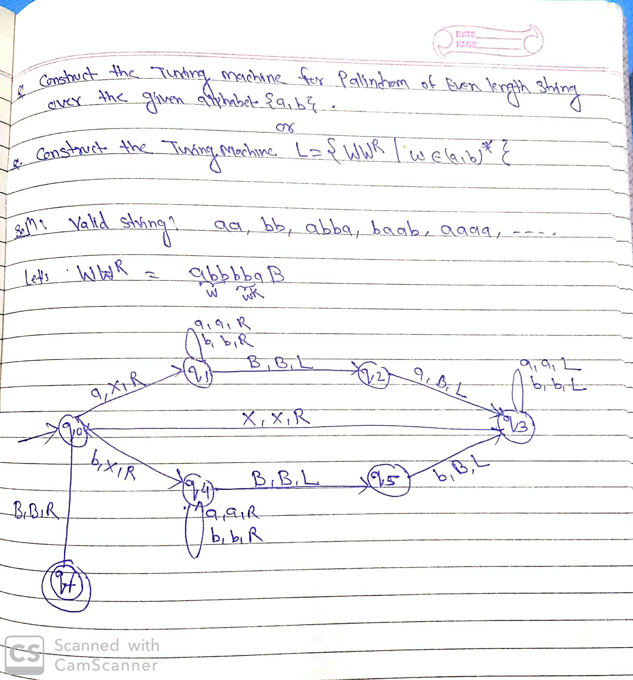
Problem-4

